Slide 1

FACULTY OF ENGINEERING & TECHNOLOGY
CleanSociety
Empowering Communities for a Cleaner, Greener Future
Mini Project - II Review B.Tech (CE) Sem-VI
At
Department of Computer Engineering Sankalchand Patel College of Engineering, Visnagar
Presented By
Dhruv V. Patel (2023095900004485)
Ayush R. Patel (2022095900004493)
Shivam N. Patel (2023095900004504)
Krish V. Patel (2022095900023543)
Harsh M. Modi (2023095900026456)
Guided By
Mr. Jinit S. Raval

Slide 2
Outline
Objective
Introduction
Functionality
Hardware & Software Requirement
Design Diagrams
References

Slide 3
Objective
Enhance urban cleanliness by enabling direct garbage collection Complaints to municipal offices
Provide a user-friendly platform for submitting and tracking garbage collection complaints.
Promote cleanliness, improve public health, and strengthen citizen-authority communication
Help municipal authorities prioritize and resolve waste-related complaints efficiently

Slide 4
Introduction
Brief overview of the project:
Why this project? To promote efficient waste management and cleaner communities by seamlessly connecting citizens with municipal offices.
CleanSociety is a platform connecting citizens with municipal offices to streamline and expedite garbage.
The platform enables citizens to report waste and track complain while allowing municipal offices to manage and monitor waste collection efficiently.
Vision of the project: To create a cleaner and healthier environment by leveraging technology to bridge the gap between citizens and municipal authorities, ensuring efficient, transparent, and prompt waste management solutions.

Slide 5




Functionality
Register Complaint for Garbage Collection
Real-Time Complaints Tracking: Users can track the status of their registered Complaints.
Municipal Dashboard: Municipal staff to view, manage, and prioritize Complaints.
Municipal teams perform the garbage collection task.

Slide 6
Functionality
Register Garbage Collection Complain: Easy form-based submission for waste collection applications.
Location Mapping: Integration with geolocation services to pinpoint garbage locations accurately.
Real-Time Complain Tracking: Users can track the status of their garbage collection Complaint.
Municipal Dashboard: Centralized dashboard for municipal staff to view, manage, and prioritize Complaints.
Data Analytics & Reporting: Insightful analytics for municipal offices to monitor and optimize waste management.
Feedback Mechanism: Citizens can provide feedback on the response and service quality.

Slide 7
Hardware & Software Requirement
Hardware Requirements:
Minimum 4 GB RAM for client-side development
Multi-core processor for backend server hosting
Software Requirements:
Frontend: HTML/CSS
Backend: PHP
Database: MySQL
Design: Figma (for UI/UX wireframing)

Slide 8
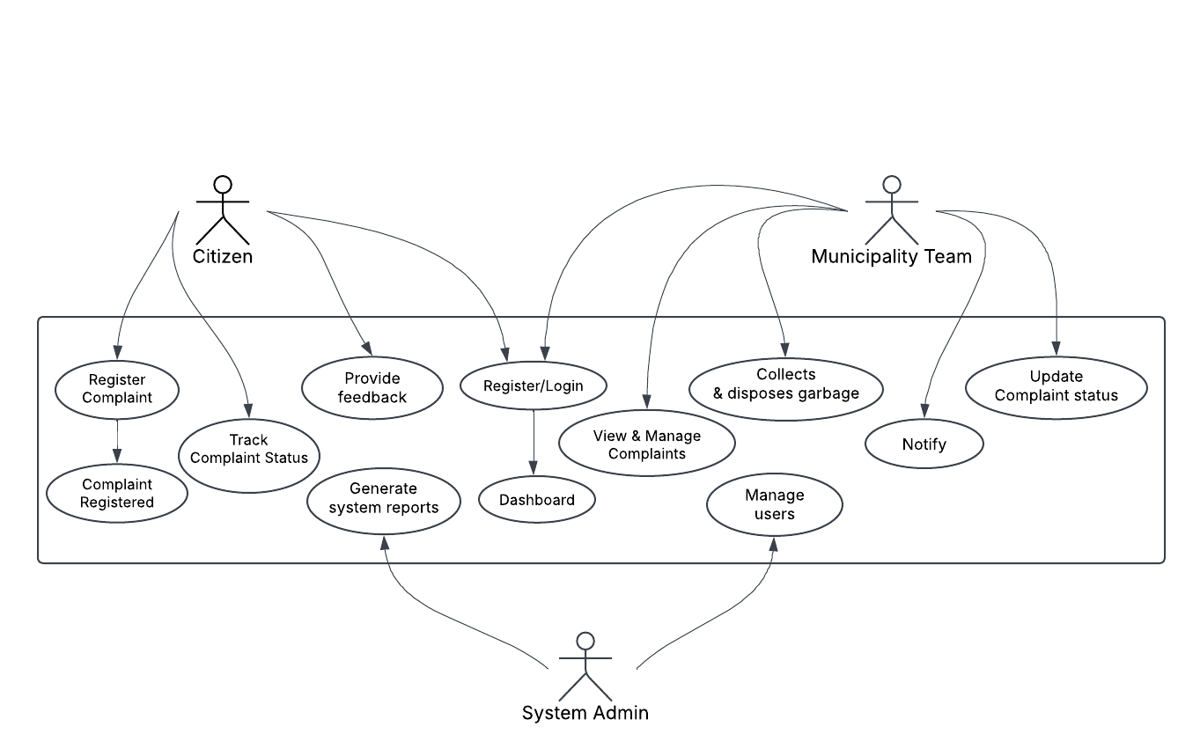
Design Diagrams
User Flow Diagram:

Slide 9
References
Government and Municipal Guidelines:
Ministry of Housing and Urban Affairs, Swachh Bharat Mission (Urban) Guidelines https://swachhbharatmission.gov.in
Municipal Solid Waste Management Rules, 2016 Ministry of Environment, Forest and Climate Change, Government of India
Local Municipal Corporation guidelines for waste management
Technical Resources
Web Development Documentation:
W3Schools - https://www.w3schools.com
MDN Web Docs - https://developer.mozilla.org
APIs for Location Integration:
Google Maps API - https://developers.google.com/maps
Real-Time Data Handling:
Firebase Documentation - https://firebase.google.com

Slide 10
Thank You..!

